Slide 1

House Price Prediction
Team MLAIRE:
Tina Agarwal
Chi Iong Ansjory
Soodong Kim
Prabhat Tripathi
Fall 2018 MIDS DATASCI W207:
Applied Machine Learning

Slide 2

Problem
Goal
Approach
Predict sale price of residential homes in Ames, Iowa based on the given training and test data sets.
80 variables, 1460 training data sets, and 1459 test data sets.
The output variable (SalePrice) is continuous.
The remaining 79 explanatory variables are combination of continuous and categorical variables.
Univariate analysis of output and explanatory variables.
Transform categorical variables into numeric variables.
Check if log transformation of output and explanatory variables helps better model performance.
Through bivariate analysis, identify and remove unhelpful explanatory variables.
Advanced feature engineering such as PCA.
Data modeling such as Linear Regression, Random Forest, and Gradient-Boost Tree.

Slide 3
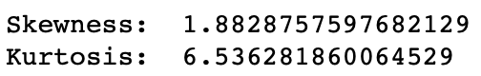
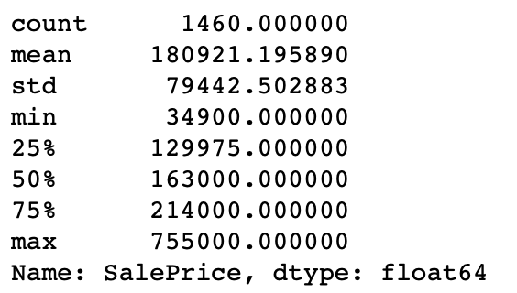
Explanatory Data Analysis (EDA)
Univariate Analysis
Bivariate Analysis
10 variables are identified highly correlated to SalePrice.
OverllQual and GarageCars show linear relationship between quality and price, size of garage and price.
SalePrice is not normal based on histogram, skewness and kurtosis.

Slide 4
Data Clean Up
WRITE TITLE
WRITE TITLE
Marketers must link the price to the real and perceived value of the product, but they also must take into account supply costs, seasonal discounts, and prices used by competitors.
In some cases. Must link the price to the real and perceived value of the product, but they also must take into account supply costs, seasonal discounts, and prices used by competitors. In some cases.
Additionally, a firm's finance department would be consulted. The marketing orientation is perhaps the most common orientation.
Marketers must link the price to the real and perceived value of the product, but they also must take into account supply costs, seasonal discounts, and prices used by competitors.
In some cases. Must link the price to the real and perceived value of the product, but they also must take into account supply costs, seasonal discounts, and prices used by competitors. In some cases.
Additionally, a firm's finance department would be consulted. The marketing orientation is perhaps the most common orientation.

Slide 5
Feature Engineering
WRITE TITLE
WRITE TITLE
Marketers must link the price to the real and perceived value of the product, but they also must take into account supply costs, seasonal discounts, and prices used by competitors.
In some cases. Must link the price to the real and perceived value of the product, but they also must take into account supply costs, seasonal discounts, and prices used by competitors. In some cases.
Additionally, a firm's finance department would be consulted. The marketing orientation is perhaps the most common orientation.
Marketers must link the price to the real and perceived value of the product, but they also must take into account supply costs, seasonal discounts, and prices used by competitors.
In some cases. Must link the price to the real and perceived value of the product, but they also must take into account supply costs, seasonal discounts, and prices used by competitors. In some cases.
Additionally, a firm's finance department would be consulted. The marketing orientation is perhaps the most common orientation.

Slide 6
Data Modeling
PROJECT ONE
PROJECT TWO
PROJECT THREE
With this in mind, the marketing department would inform the department to create a prototype. The production department would then start to manufacture the product, while the marketing department. With this in mind, the marketing department would inform the department to create a prototype.
With this in mind, the marketing department would inform the department to create a prototype. The production department would then start to manufacture the product, while the marketing department. With this in mind, the marketing department would inform the department to create a prototype.
With this in mind, the marketing department would inform the department to create a prototype. The production department would then start to manufacture the product, while the marketing department. With this in mind, the marketing department would inform the department to create a prototype.

Slide 7
Summary & Key Results
WRITE TITLE
WRITE TITLE
Marketers must link the price to the real and perceived value of the product, but they also must take into account supply costs, seasonal discounts, and prices used by competitors.
In some cases. Must link the price to the real and perceived value of the product, but they also must take into account supply costs, seasonal discounts, and prices used by competitors. In some cases.
Additionally, a firm's finance department would be consulted. The marketing orientation is perhaps the most common orientation.
Marketers must link the price to the real and perceived value of the product, but they also must take into account supply costs, seasonal discounts, and prices used by competitors.
In some cases. Must link the price to the real and perceived value of the product, but they also must take into account supply costs, seasonal discounts, and prices used by competitors. In some cases.
Additionally, a firm's finance department would be consulted. The marketing orientation is perhaps the most common orientation.

Slide 8
References
WRITE HERE YOUR TITLE
With this in mind, the marketing department would inform the department to create a prototype. Marketers must link the price to the real and perceived value of the product, but they also must take into account supply costs, seasonal discounts, and prices used by competitors. In some cases.
The production department would then start to manufacture the product, while the marketing department. Marketers must link the price to the real and perceived value of the product, but they also must take into account supply costs, seasonal discounts, and prices used by competitors. In some cases.
Additionally, a firm's finance department would be consulted. The marketing orientation is perhaps the most common orientation. Marketers must link the price to the real and perceived value of the product, but they also must take into account supply costs, seasonal discounts, and prices used by competitors. In some cases.

Slide 9
Thank you! Questions?
Team MLAIRE
(Machine Learning Artificial Intelligence Real Estate)

Slide 10

IPHONE MOCKUP
Some fifty years ago there was a curious case of whale trover litigated. Likewise a fish is technically fast when it bears a waif, or any other recognized symbol of possession. These are scientific commentaries; but the commentaries of the whale men themselves sometimes consist in hard words and harder knocks.

Slide 11

IPAD MOCKUP
Some fifty years ago there was a curious case of whale trover litigated. Likewise a fish is technically fast when it bears a waif, or any other recognized symbol of possession. These are scientific commentaries; but the commentaries of the whale men themselves sometimes consist in hard words and harder knocks.

Slide 12

MACBOOK MOCKUP
Some fifty years ago there was a curious case of whale trover litigated. Likewise a fish is technically fast when it bears a waif, or any other recognized symbol of possession. These are scientific commentaries; but the commentaries of the whale men themselves sometimes consist in hard words and harder knocks.

Slide 13
GENERAL

